Slide 1
RVC_ASAP RISCV Core As-Soon-As-Possible 5-Stage Core Design implemented on FPGA
Gil Ya'akov
Matan Eshel
Adviser: Amichai Ben-David (Intel & Nvidia)

Slide 2
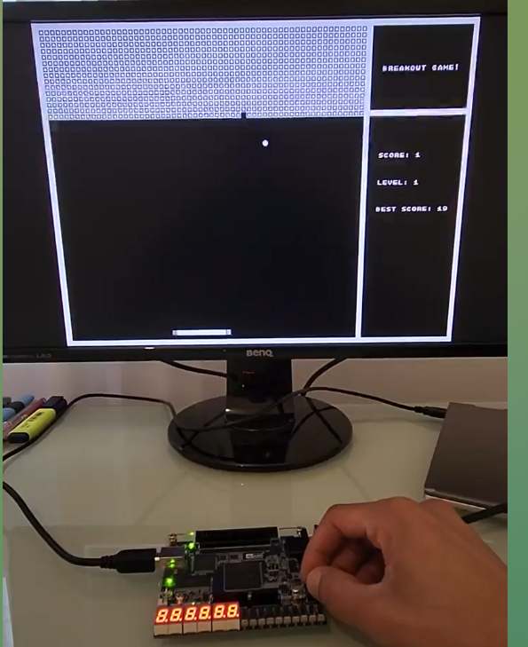
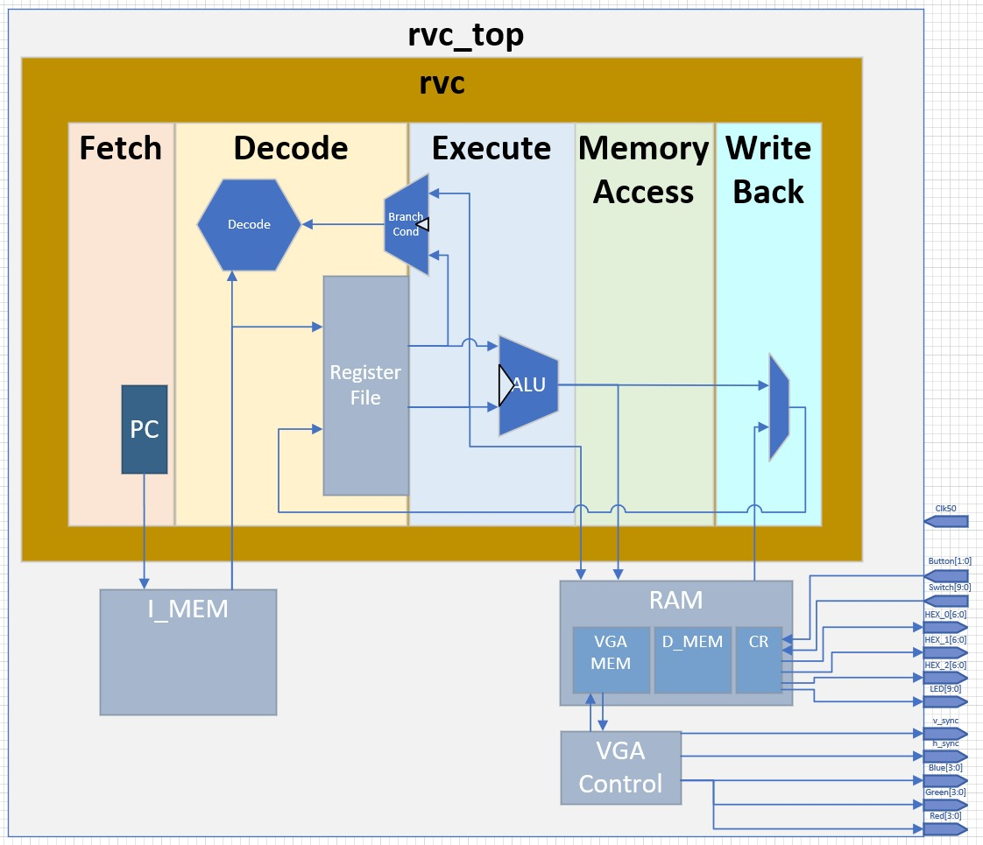
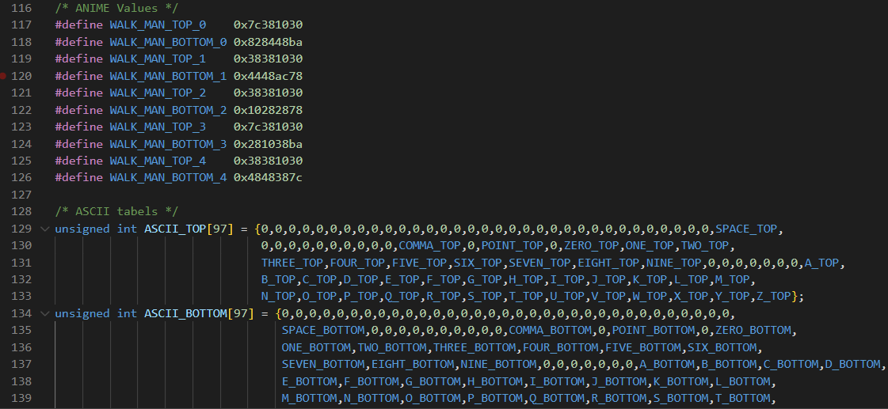
Our project
RISC-V 32I Core A General Purpose 5-stages pipeline Compute Unit.
Runs compiled high-level language Programed in C Designed a graphic library & Compatible HW for VGA screen display
Loaded to FPGA Supports the FPGA I/O peripherals. Button, switch LED, 7SEG & VGA
Notes:
100% from our code and

Slide 3
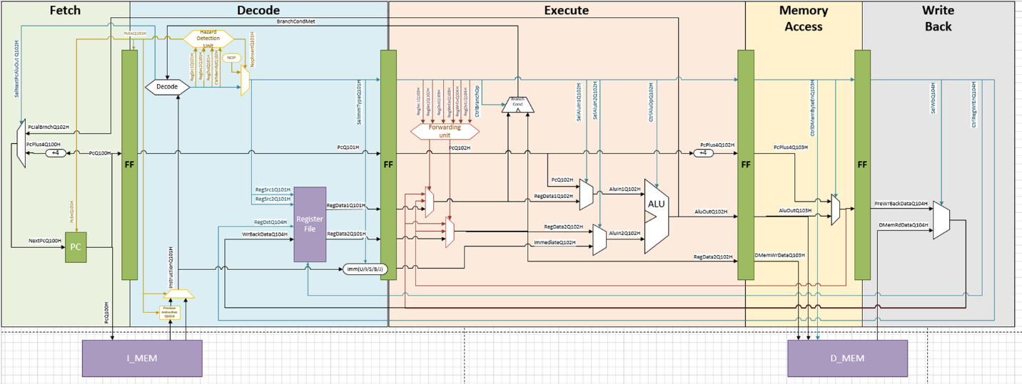
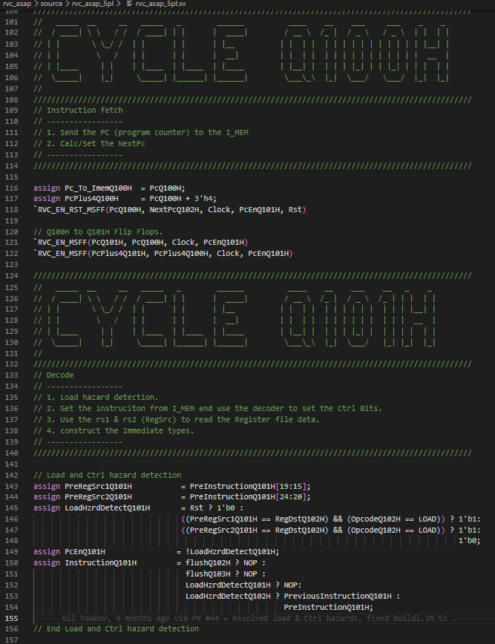
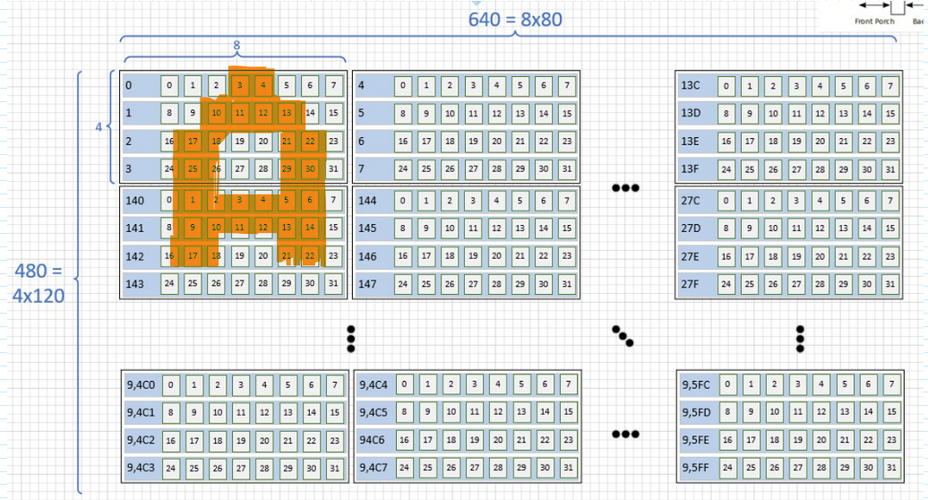
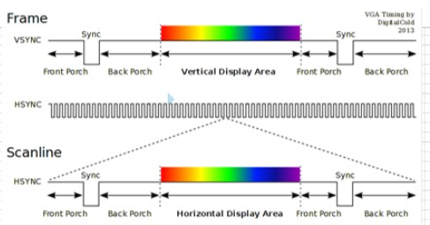
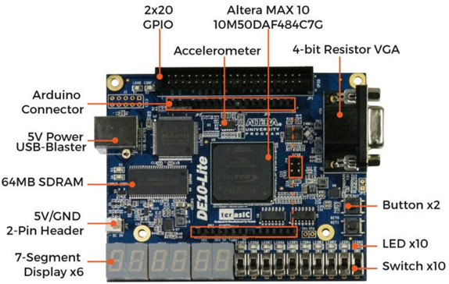

Slide 4



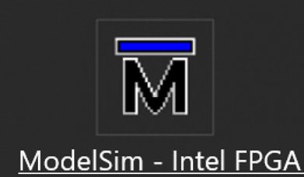

TFM: TOOLS, FLOW & METHODOLOGY
Git Bash
ModelSim
Quartus
Visual Studio Code
GitHub
Notes:
Git Bash: An application for Microsoft Windows environments that provides an emulation layer for the Git command line experience.
ModelSim A multi-language environment for simulation of hardware description languages such as VHDL, Verilog and SystemC.
Quartus A programmable logic device design software that enables analysis and synthesis of HDL designs, which enables the developer to compile their designs, perform timing analysis etc.
Visual Studio Code A streamlined code editor with support for development operations like debugging, task running, and version control and comfortable because its variety of efficient extension
Git a well-known software for tracking changes in files. work on them simultaneously and upload them to a common cloud stored in github.com. also used us for solving merge conflicts and track changes.
GitHub We used GitHub to store our repository which include all the project files. And apply version control using Git.

Slide 5
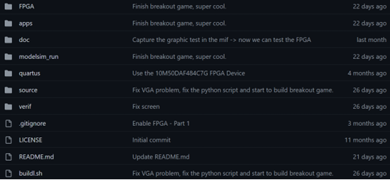
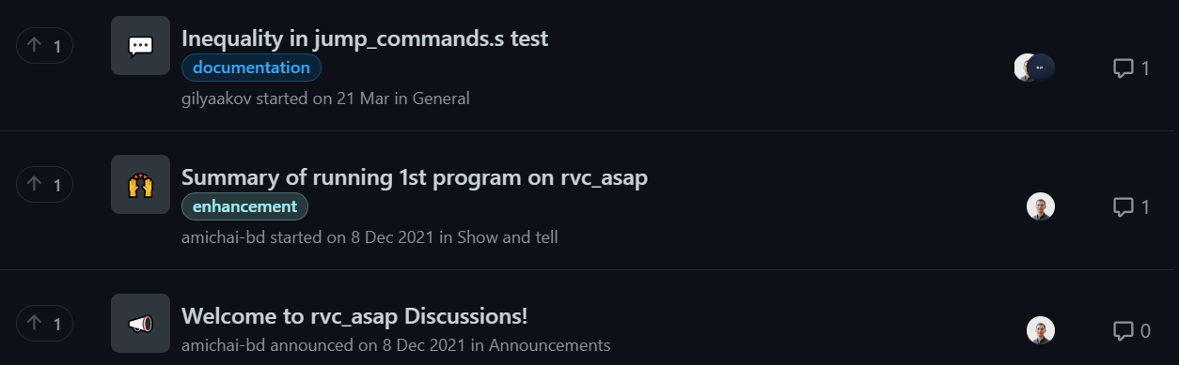
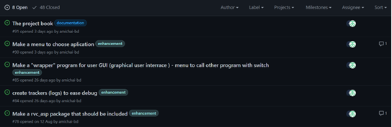
GitHub facilities
Code & Code Review Pull, merge, push
Discussions and Questions
Task Management
Notes:
Code & Code Review Each contributor can upload his code and receive a code review before the new uploaded code is merged with the complete repository code.
Discussions and Questions One of the many contributors can answer a problem we encountered in, in our work. When we upload it to this section
Task Management Used by Issues tab on Github. Each meeting with the advisor we assign tasks between us and detailed about the task in its page.

Slide 6
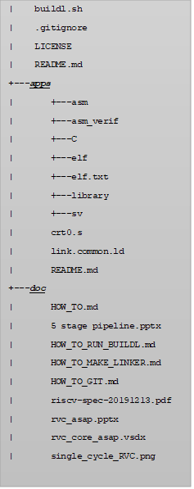
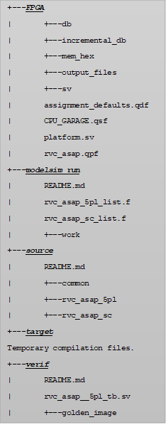
Repository structure
doc
apps
FPGA
Source
verif
modelsim_run
target

Slide 7
HW architecture & challenges

Slide 8

The challenges
Designing an original 5 stage core.
Supporting all various opcodes and parameters of RV32I ISA.
Solve all hazards with forwarding units, pipe flush, etc.
Design a synthesizable model with behavioral memory. Which will translate correctly to a FPGA/ASIC.
Design a simulation & verification environment.

Slide 9

HIGH-LEVEL-SPECIFICATIONS
The Core:
5-Stage in-order pipeline core.
RISCV RV32I ISA compatible.
Hazard detection and forwarding units.
Memory access is word-aligned (4 bytes).
Peak performance Instructions Per Cycle (IPC) of 1 (~0.7 to be precise).
Memory Wrapper :
Instruction Memory - contains the program.
Data Memory - accessible with LOAD & STORE .
Control Registers - handles the communication with the FPGA peripherals.
VGA Controller - handles the communication with the screen.

Slide 10
Building Blocks

Slide 11
Memory regions
RVC_ASAP has a total of 69.5kb S-RAM memory.
In addition to Flip-Flop memories and Registers File.
Distribution of the memory space as it is depicted from
the processor's point of view:
Region | Start address | End address | Description
I_MEM | 0x00000000 | 0x00003FFF | 16kb of Instruction Memory
D_MEM | 0x00004000 | 0x00006FFF | 16kb of Data Memory
CR_MEM | 0x00007000 | 0x00007FFF | Control Register Memory as part of Data Memory allocation
VGA_MEM | 0x00008000 | 0x000115FF | 32.5kb of VGA Memory

Slide 12
HW Verification & automation
In RVC_ASAP project validation was critical to ensure the correctness of RVC_ASAP core and memory functionality.
we checked RVC_ASAP functionality with ModelSim simulations on a Test Bench.
Test Bench is an environment used to verify the correctness or soundness of a design or model.
In our project, the Test Bench:
Instantiate the top view of the design.
Provides clock and reset signals to the design.
Loads the instruction and the data memories by a backdoor load and monitors them.
Creating a snapshot of the data memory.
Creating a snapshot of the VGA memory region to simulate screen printing.

Slide 13

HW Verification & automation
In the final stage we check the results by conduct a comparison between actual output of the test to the memory and its golden image.
Golden image is pre-generated memory image produced from Venus RISC-V simulator.
Golden image is pre-generated memory image produced from Venus RISC-V simulator.
As part of the automation process, the buildl.sh script compares the two files and alerts if there is a discrepancy between the two files and where the discrepancy exists.

Slide 14
SW architecture & challenges

Slide 15
The challenges
Writing appropriate SW for the specific HW.
Consideration of the size of the Instruction Memory, the Data Memory and the Stack Memory when writing the SW.
Consideration of the operation rates of the VGA controller to enable a quality user experience.

Slide 16
SW architecture
RVC_ASAP Initialization Assembly code file:
a file named crt0.s which contains a code written in RISC-V Assembly that supposed to run on the RVC_ASAP Test Bench before any C program.
Linker script file:
An LD file, which is a script written in the GNU Linker Command Language.
The Toolchain use the linker to link the crt0.s code and the program Assembly code to a single Assembly program.
It also defines the sizes and origin addresses of the Instruction and Data Memories and the Stack Memory.
Assembler:
Program that takes basic computer instructions and converts them into a pattern of bits that the computer's processor can use to perform its basic operations.
Notes:
The main flow of the build process is as follow:
We built the main build script called buildl.sh that performs the entire process described here automatically.
We built 24 tests in C and Assembly languages that test different things. In the book we take, for example, a basic test that performs Bubble Sort.
More details about this script on the book or here at the appendix

Slide 17
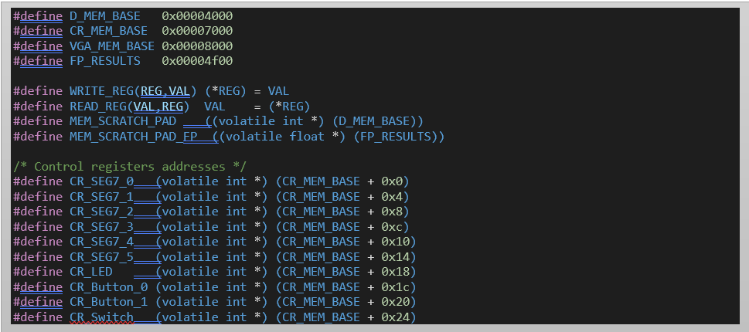
SW architecture
HW API
The hardware resource APIs allow you to work with hardware resources.
In our project the basis of the communication through the software with the hardware, thereby substituting the HW API, is the defines which are defined in the file rvc_defines.h.
Notes:
The main flow of the build process is as follow:
We built the main build script called buildl.sh that performs the entire process described here automatically.
We built 24 tests in C and Assembly languages that test different things. In the book we take, for example, a basic test that performs Bubble Sort.
More details about this script on the book or here at the appendix

Slide 18
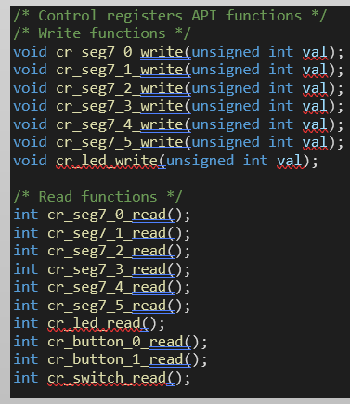
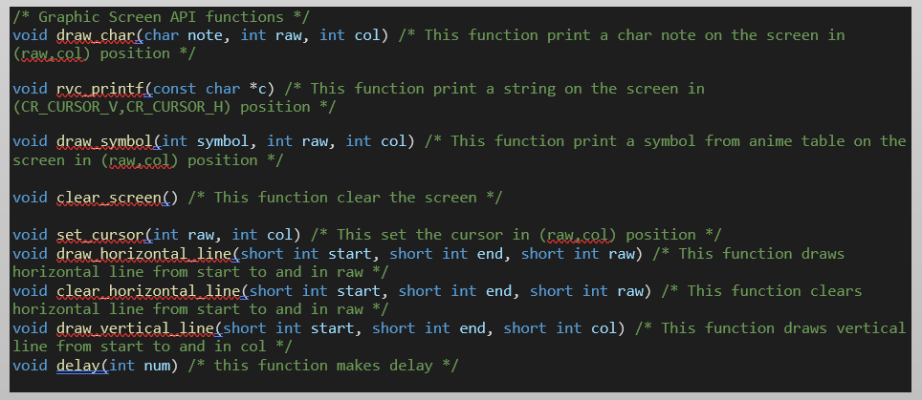
SW architecture
CR API
Responsible for communication between the software and the peripheral components that are on the FPGA.
Graphic Screen API
Responsible for communication between the software and the screen.
Notes:
The main flow of the build process is as follow:
We built the main build script called buildl.sh that performs the entire process described here automatically.
We built 24 tests in C and Assembly languages that test different things. In the book we take, for example, a basic test that performs Bubble Sort.
More details about this script on the book or here at the appendix

Slide 19
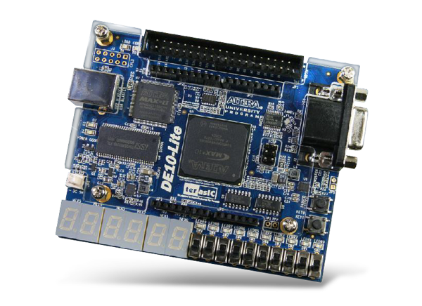
Moving to FPGA and VGA support architecture & challenges

Slide 20
The challenges
Succeed in burning our Core to the FPGA and supply all the parameters it is needed.
Support in our code in all the I\O peripherals like Buttons, Switches etc.
Writing software to create graphics on the screen.

Slide 21
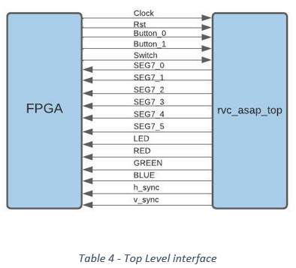
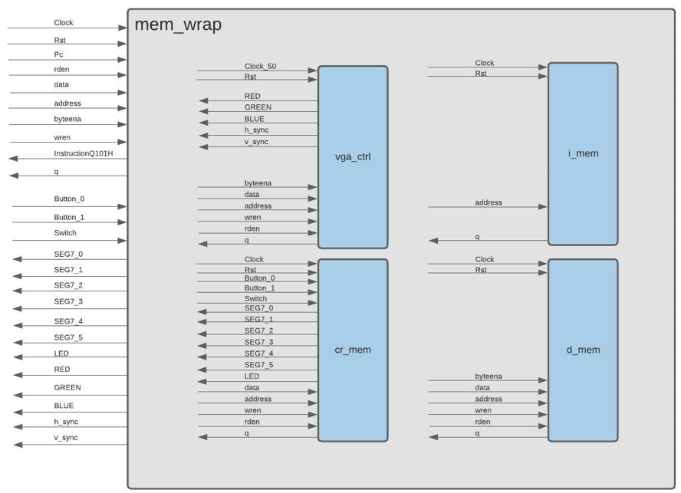
Top Level

Slide 22
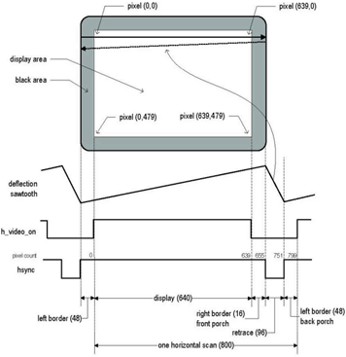
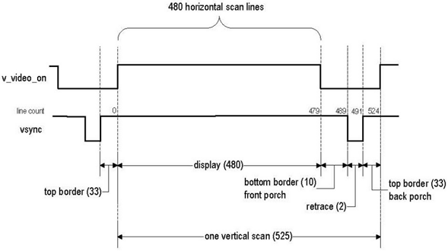
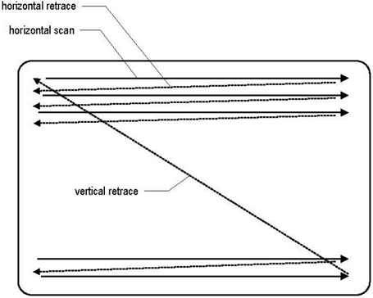
VGA Controller
Horizontal Synchronization Vertical Synchronization

Slide 23
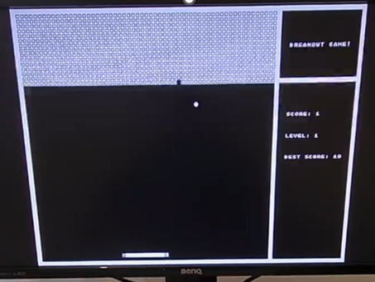
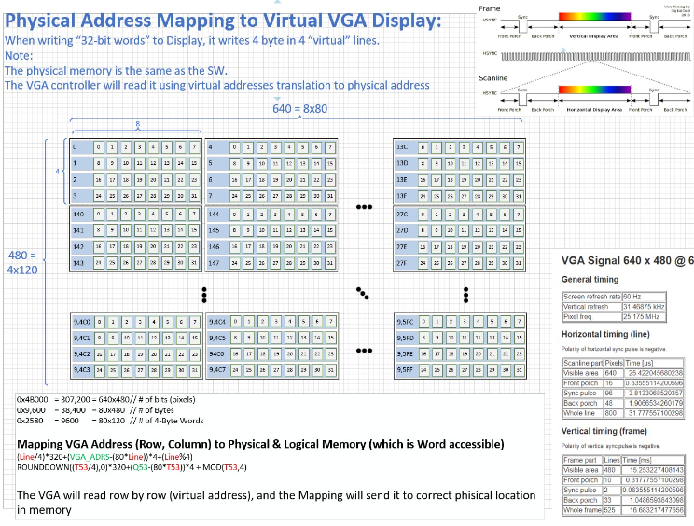
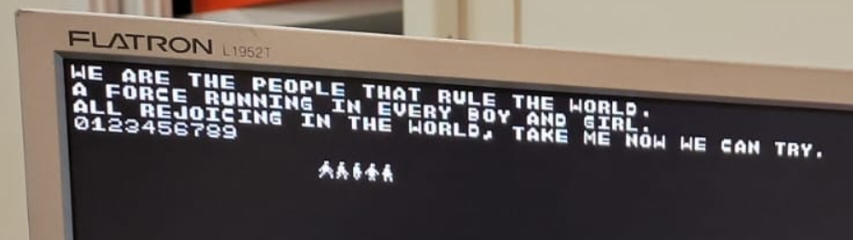
VGA_MEM
How we translate from this: to this :

Slide 24
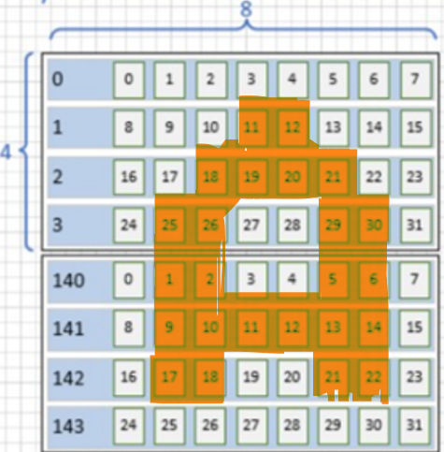
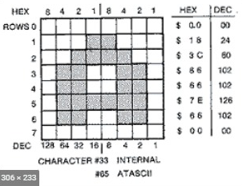
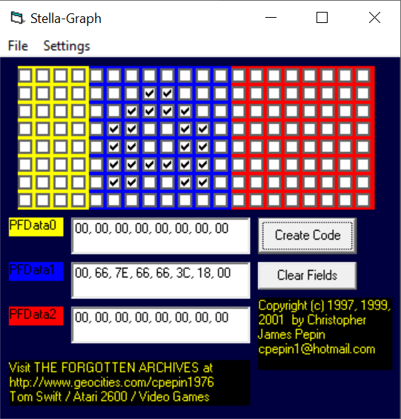
Our Print Library
Defined an ASCII tables and a symbol table which are loaded into the program memory.
The ASCII tables are ASCII_TOP and ASCII_BOTTOM.
The TOP part of the character consists of the top 32 bites – from byte 0 to byte 3.
The BOTTOM part of the character consists of the bottom 32 bits – from byte 4 to byte 7.

Slide 25
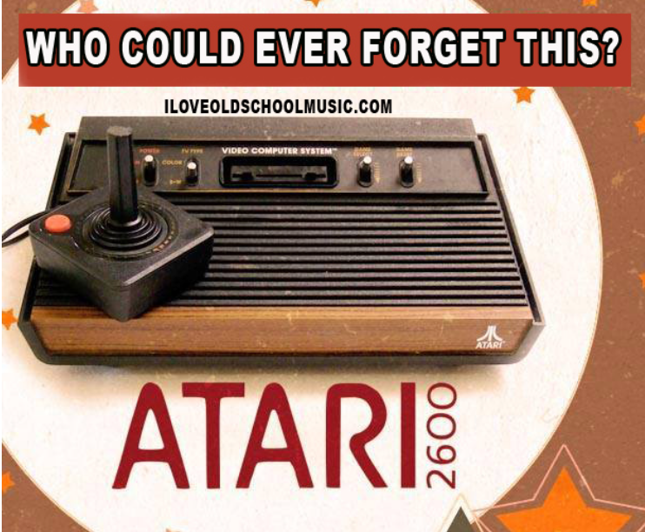
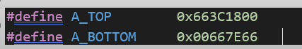
Our Print Library
We used a tool called Stella-Graph.
The program generates the appropriate hex values to include in the source code.
This tool provided us with the coding of each letter and each symbol so that we created pre-coded defines for the characters and symbols that are ready to use.

Slide 26
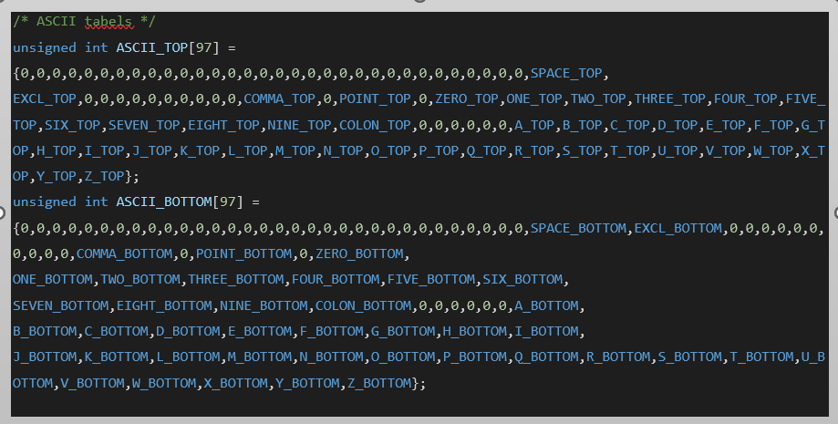

Our Print Library
We created the ASCII table in such a way that to get the bitmap of a certain character we turn to the array in the place that corresponds to the ASCII value of this character.
For example, the ASCII value of the character 'A' is 65 therefore, in place of 65 in the ASCII_TOP table the top part of the letter 'A' appears and same thing too in the ASCII_BOTTOM table.
Hard Job! But now everyone can draw whatever they want.

Slide 27
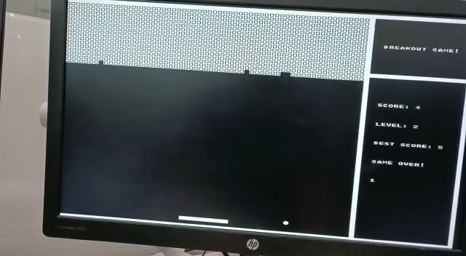

Slide 28

Future Plans
Our project is an amazing foundation for a wide variety of interesting and fascinating projects in both hardware and software fields. directions listed is a basis for a complete graduation project. Here are the plans to continue:
Expanding the API functions and writing additional service functions such as malloc using a heap structure.
Writing a lite operating system for creating and managing processes including scheduling, control, and interrupt mechanisms.
Create L1 cache, and a controller for memory management including the implementation of error correction codes.
Building arithmetic circuits for fast addition, subtraction, multiplication, and division.
Create OOO (Out-Of-Order) execution by implementing a ROB (Re-Order Buffer).
Implement Branch Predictor.
Implement RISC-V extensions (M/F/A/CSR).
Implement Interrupts & Exceptions.
IO – UART.
Connect Keyboard.
RGB Mode – lower the resolution of the screen but get RGB capabilities.

Slide 29
The End

Slide 30
Question?

Slide 31
Appendix 1 - MAS

Slide 32

Micro-Level Architecture
Logic Design implementation of RVC_ASAP Architectonic demands
I need “5pl-core” with VGA screen support
HAS
MAS

Slide 33
MAS more details about the HW architecture press here

Slide 34
Instruction Fetch (Q100H)
Send PC (Program Counter) to Instruction Memory.
Set Next PC – (PC + 4) or calculated address. (PcQ100H is the actual PC that sent to Instruction Memory)
The branch resolution is in Execute stage (Q102H). The two options:
condition met – PcQ100H will get the jump target address in next cycle
it not met – PcQ100H will get PcQ100H + 4.

Slide 35
Decode (Q101H)
Contain Load & Control hazard detection.
Receiving instruction from Instruction Memory and using decoder to turn on the relevant control bits.
Config the ALU operation in case of R_TYPE instruction.
Building the immediate types.
Using RS1 and RS2 to read the Register File.

Slide 36
Execute (Q102H)
(Data) Hazard Detection.
Forwarding Unit.
ALU operations:
Calculate of the information for writing back to the Register File.
address calculation for Store/Load instructions.
Calculate of target address for Jump/Branch.
Branch Resolution:

Slide 37
Memory (Q103H)
Access to RAM for reading and writing
examine the lower 2 bits of the addresses we access
accordingly perform a non-cyclical shift to the information and the byte enable signals to enforce word alignment accesses to the memory.

Slide 38
Write Back (Q104H)
Selecting the information to be written back to the Register File – The ALU source or the memory source.
First, we undo the operation of the shift that we performed in the previous step so that we do not allow crossword reads.
We handle the sign bit according to the type of instruction - signed or unsigned
and choose what to write back to the register file - the ALU source or the memory source. Return to presentation

Slide 39
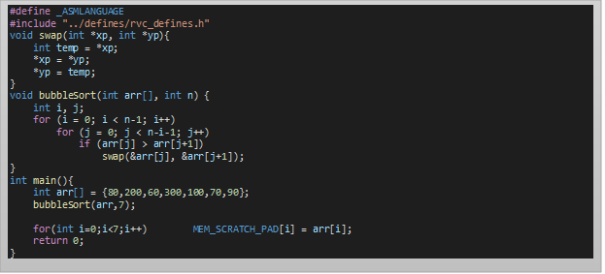
Appendix 2 - buildl.sh test example
Now, we will go through the various steps in the build process and indicate how they are realized.
In total, we built 24 tests in C and Assembly languages that test different aspects of the processor. Here, for example, a basic test that performs Bubble Sort. The test is called BubbleSort.c and it performs Bubble Sort on integers array.
At each stage, we will touch on the important details for that stage and attach figures that illustrate what is being done at each stage.

Slide 40
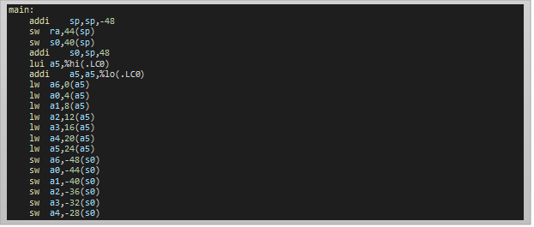
Appendix 2 - buildl.sh test example
SW Build .
1. Compile – Compile the C program to RV32I Assembly code by the following command: rv_gcc -S -ffreestanding -march=rv32i BubbleSort.c -o BubbleSort.s
A part from the main function of BubbleSort.s as it is shown in Assembly language.

Slide 41
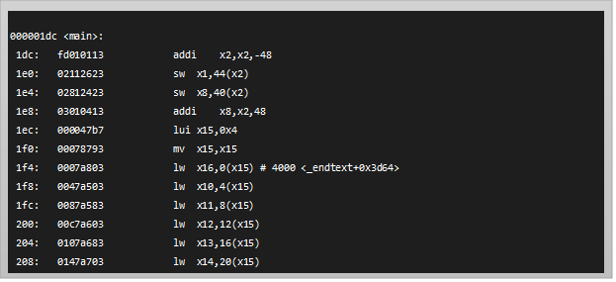

Appendix 2 - buildl.sh test example
SW Build:
1. Compile – Compile the C program to RV32I Assembly code by the following command: rv_gcc -S -ffreestanding -march=rv32i BubbleSort.c -o BubbleSort.s
A part from the main function of BubbleSort.s
2.Assembler & Linker – Assemble the Assembly program to object file and link the output with the assembled crt0.s file – crt0.o to get ELF file (Executable and linkable Format) by the following command: rv_gcc -O3 -march=rv32i -Tlink.common.ld -nostartfiles -D__riscv__ crt0.s BubbleSort.s -o BubbleSort.elf
BubbleSort.elf

Slide 42
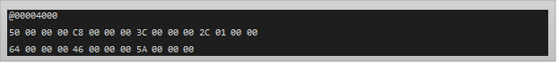
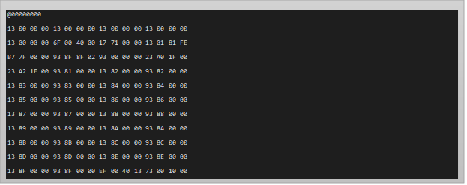
Appendix 2 - buildl.sh test example
SW Build:
3. ELF to SV – Compile the ELF file to System Verilog file (.sv) which contains the instruction and data memories content. rv_objcopy --srec-len 1 --output-target=verilog BubbleSort.elf BubbleSort-inst_mem_rv32i.sv
buildl.sh script will separate this single output file into two separate files so that each one is loaded separately in Test Bench to its appropriate memory region:
(Instruction Memory or Data Memory) by the following command:
BubbleSort_Data.sv
BubbleSort_Instruction.sv

Slide 43
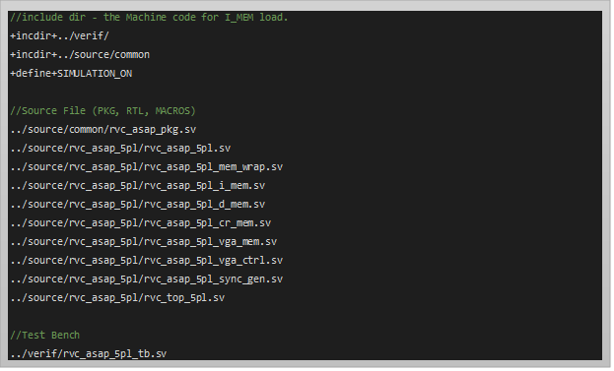
Appendix 2 - buildl.sh test example
HW Build
1. Hardware Compilation – Compile all the architecture including the Test Bench and all the files present in the list.f file by the following command: vlog.exe +define+HPATH= BubbleSort -f list.f

Slide 44
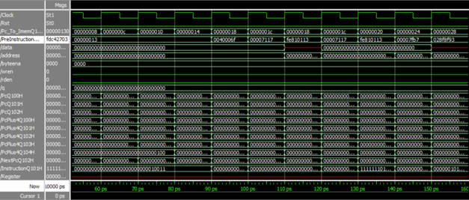
Appendix 2 - buildl.sh test example
2. Simulation – Simulate the Test Bench with ModelSim by the following command: vsim.exe -gui work.tb
The debug technique was to follow the signals in relation to what we would expect to see and what we see.
If we detected an anomaly, then we returned to the implementation of the hardware to understand what caused the anomaly and thus correct it.
The key to success in these cases is to start by building simple test plans and gradually increase the complexity of the plans. A wave diagram of running the BubbleSort.c program on the design.
In the attached wave diagram, you can see the NOP instruction that appears in the crt0.s file in the square surrounded by red.

Slide 45
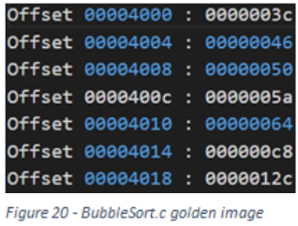
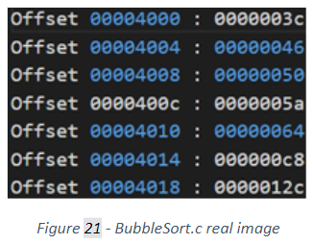
Appendix 2 - buildl.sh test example
3. Check the results – In the final stage we check the results by conduct a comparison between actual output of the test to the memory and its golden image as described in Checker section.
As you can see, the snapshots match and the numbers in the array are sorted as required. As a result, the test was passed successfully.
Back to the presentation

